Slide 1
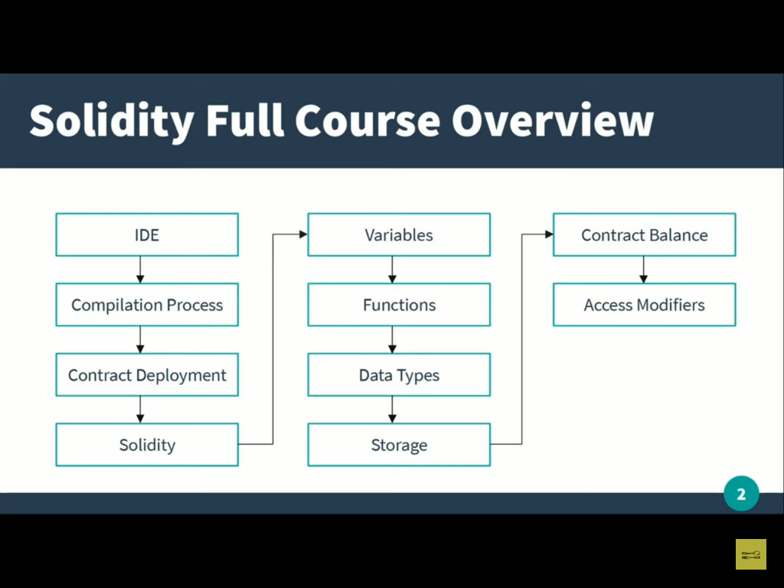
Solidity overview

Slide 2
Smart Contract compilation process
By the process of smart contract compilation you will understand how smart contract runs on ethereum blockchain.
How one smart contract communicate with the other smart contract.

Slide 3
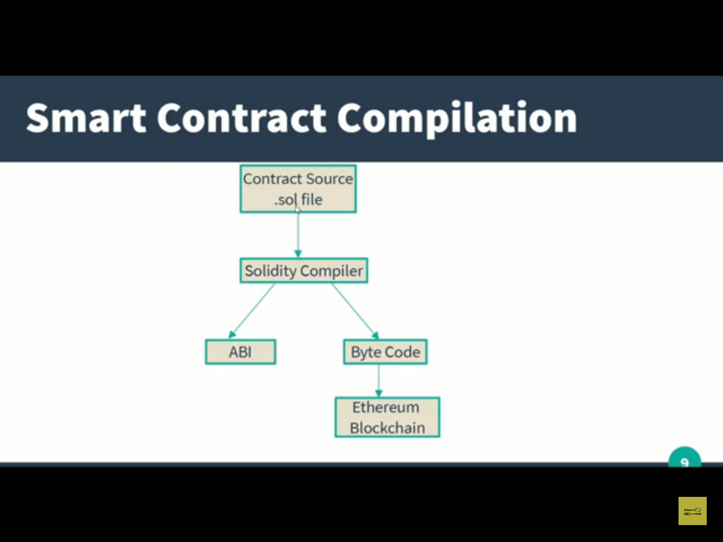

Slide 4
The bytecode deploy on ethereum blockchain. ABI(abstract binary interface)-It makes sure that any smart contract can communicate with other smart contract. Without ABI file it is not possible to share the data among different smart contract or can not call the function. It is bridge between one smart contract and the other smart contract or another application. Lets understand how ABI and bytecode can be generated using RemixIDE. On ethereum blockchain the whole smart contract does not deploy only the bytecode is deploy. Bytecode is the actual thing which runs on our ethereum blockchain not the full smart contract.

Slide 5
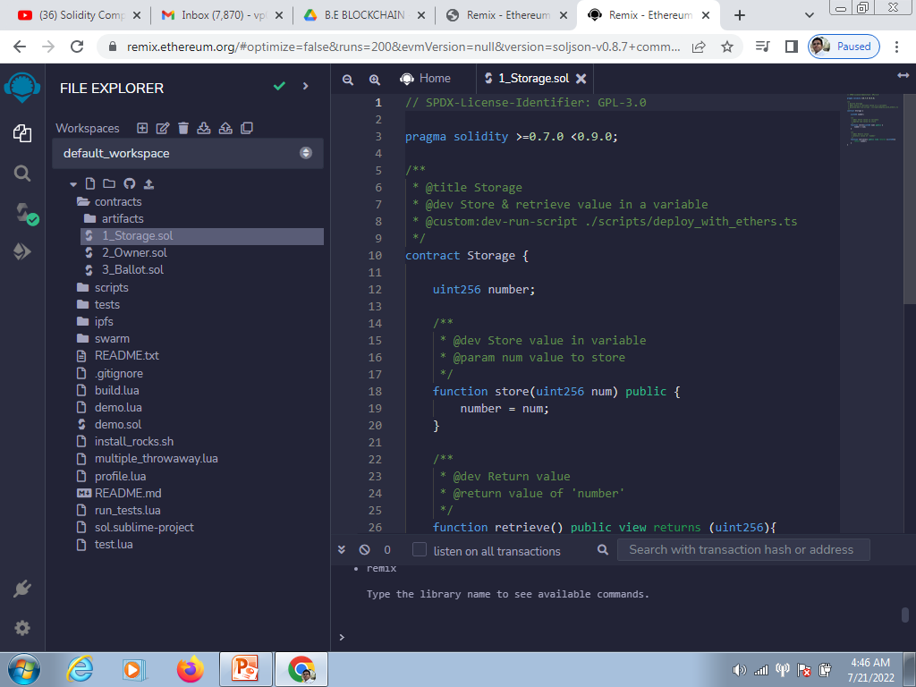

Slide 6
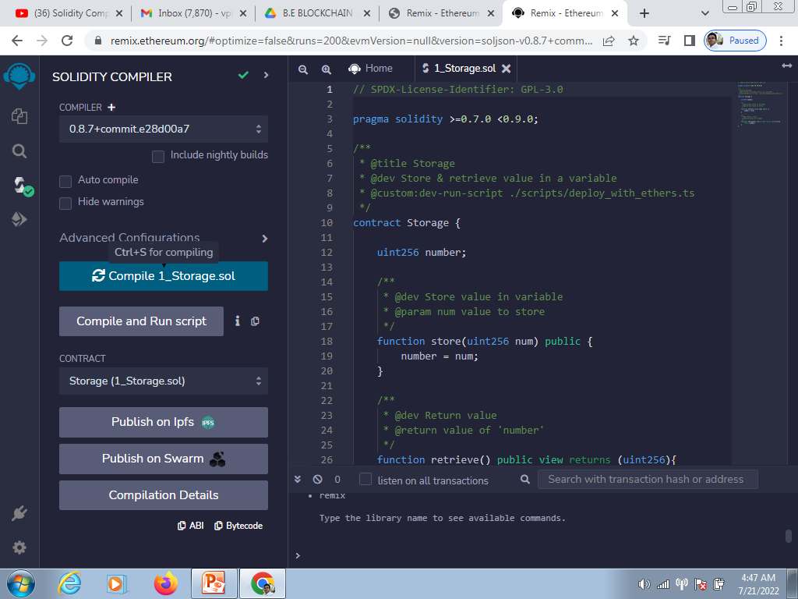

Slide 7
Copy the bytecode in any notepad file. The segment before opcode will be our bytecode and it is written using json format. The values starting from object is bytecode and from bytecode we can generate the opcode. Opcodes are those instructions which is to be executed by the EVM(Ethereum virtual machine). Opcodes are the part of the intstructions. In normal program suppose we write a+b here + indicates the opcode. Opcodes comes from the bytecode. For demonstration you can copy the bytecode excluding the double quotes. Before pasting the bytecode make sure that you ca written 0x bcz it is in the form of hexadecimal values.

Slide 8
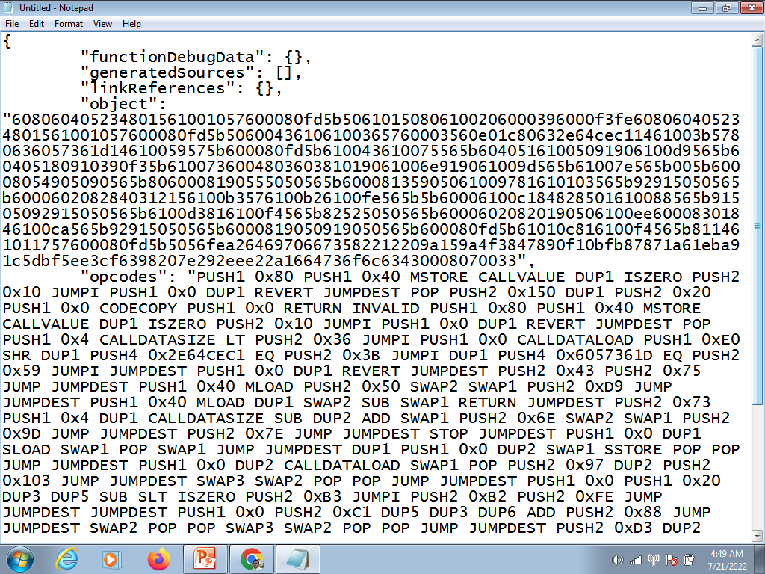

Slide 9
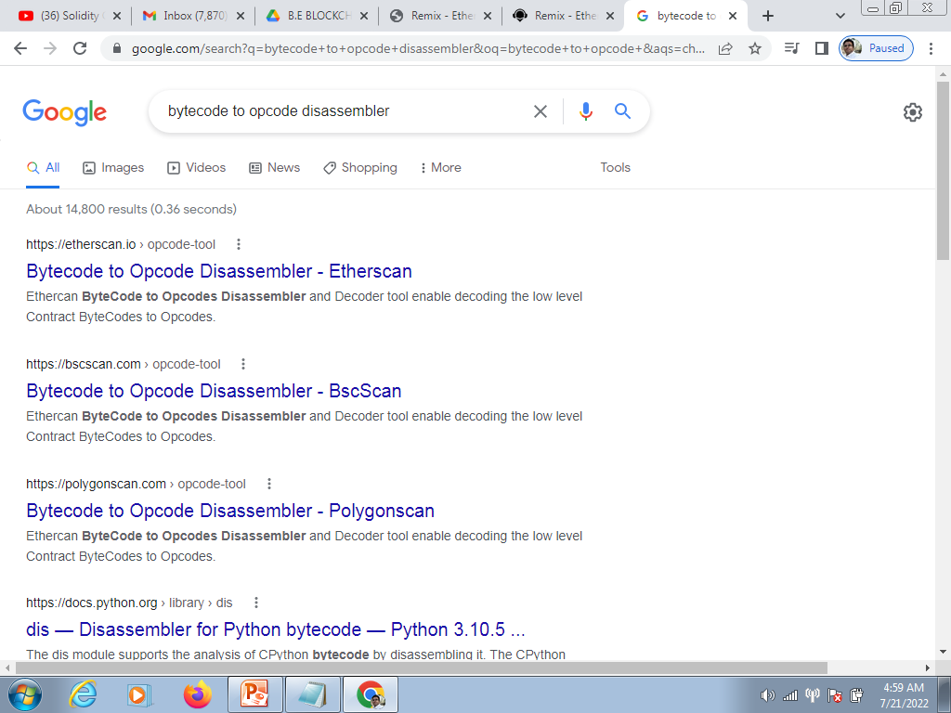

Slide 10
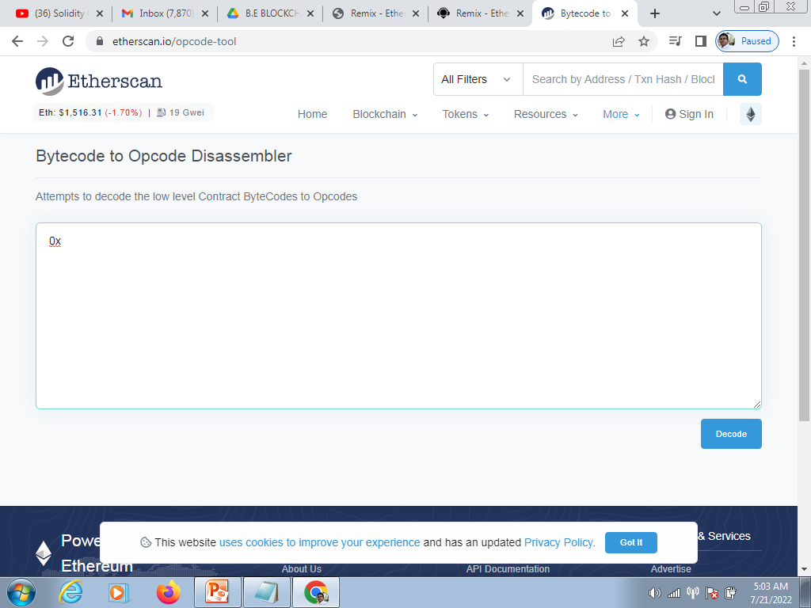

Slide 11
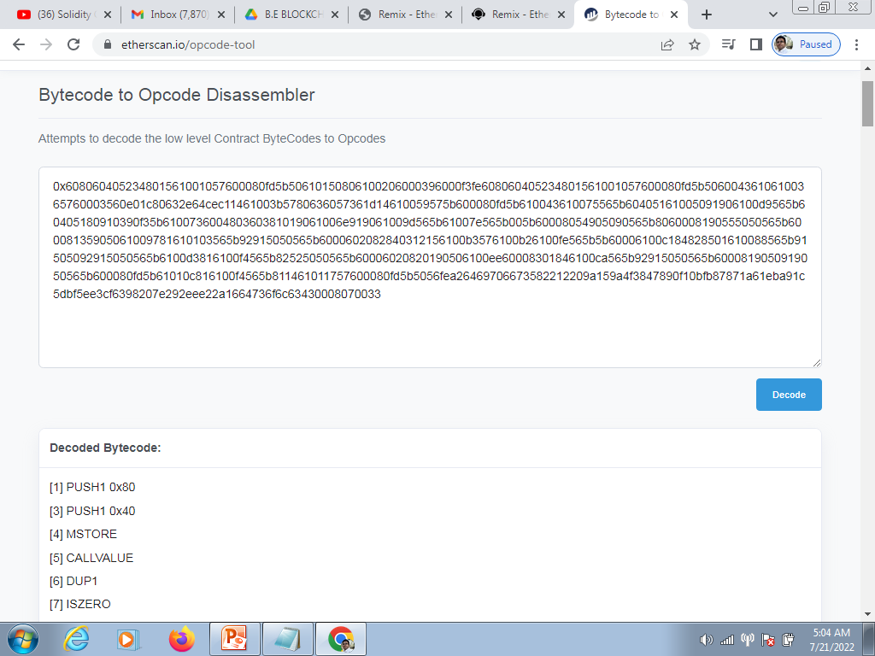

Slide 12
EVM will follow these opcode instructions. The table represents which opcode indicates which instructions. Now copy the ABI file in the notepad.

Slide 13
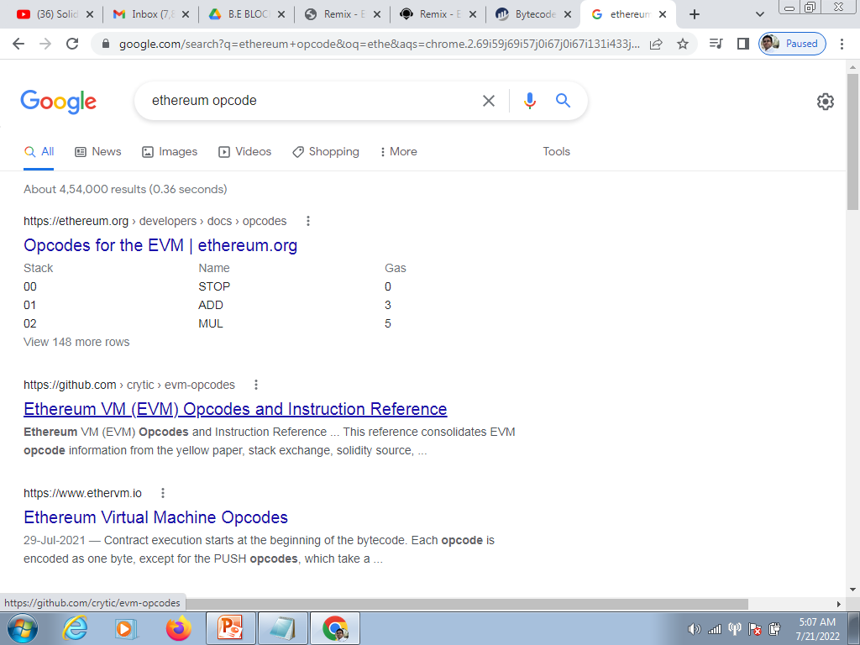

Slide 14
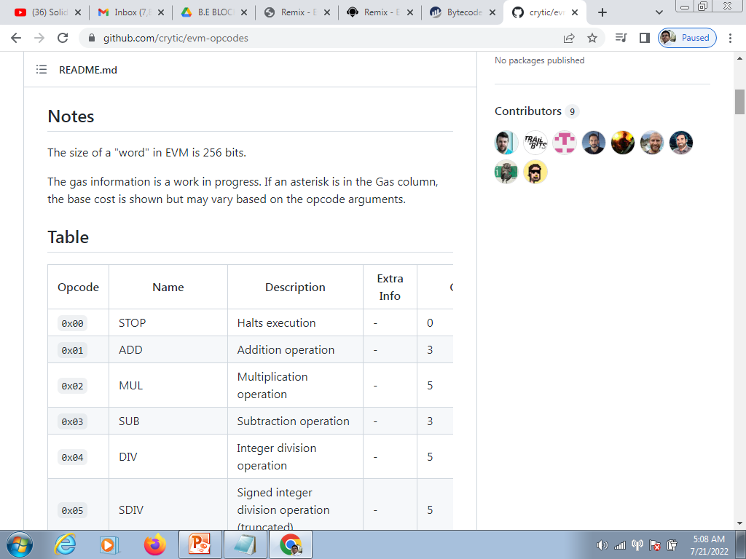

Slide 15
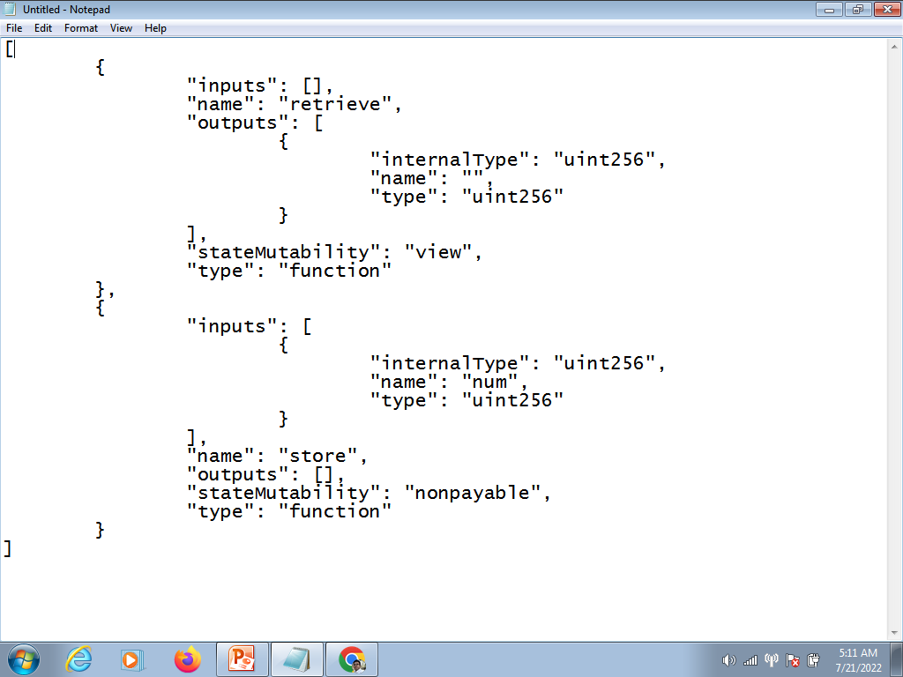
The content of the ABI file will be as follows-

Slide 17
Using ABI we can communicate with the smart contract . It is written in json format

Slide 18
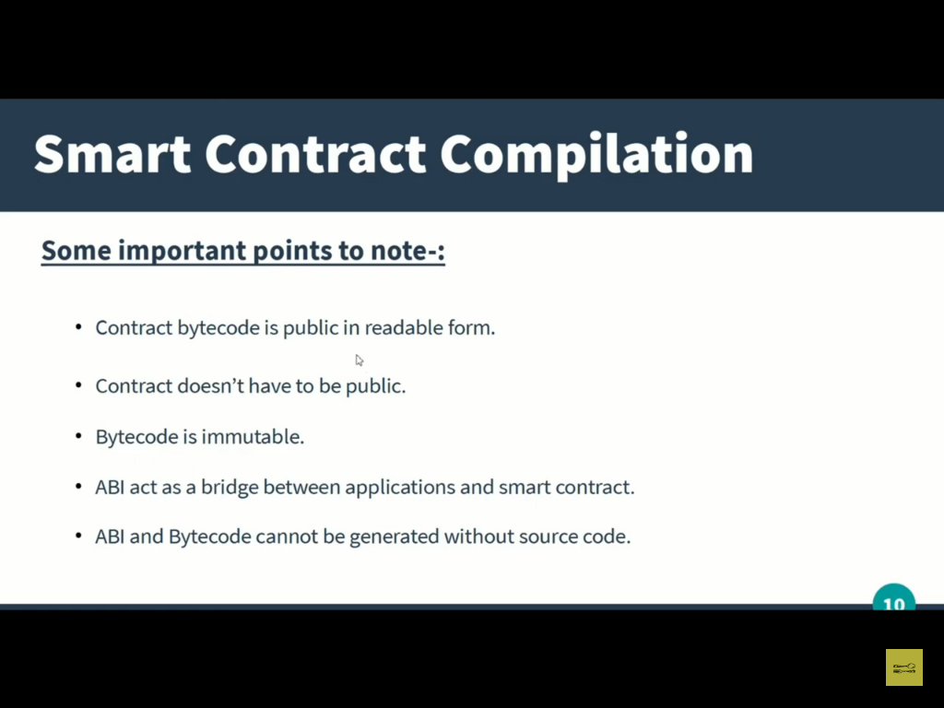

Slide 19
From smart contract (.sol file )we can generate the ABI and bytecode file but reverse process is not possible.It is one way process.

Slide 20
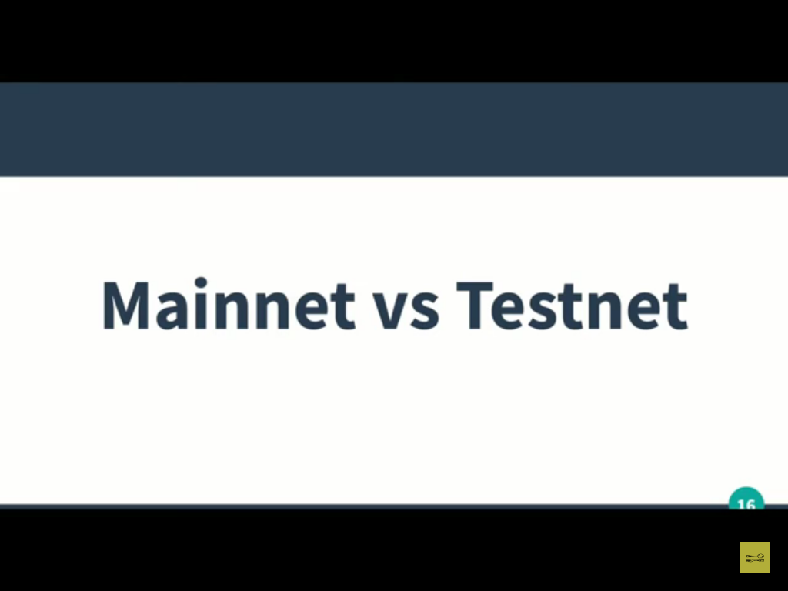

Slide 21
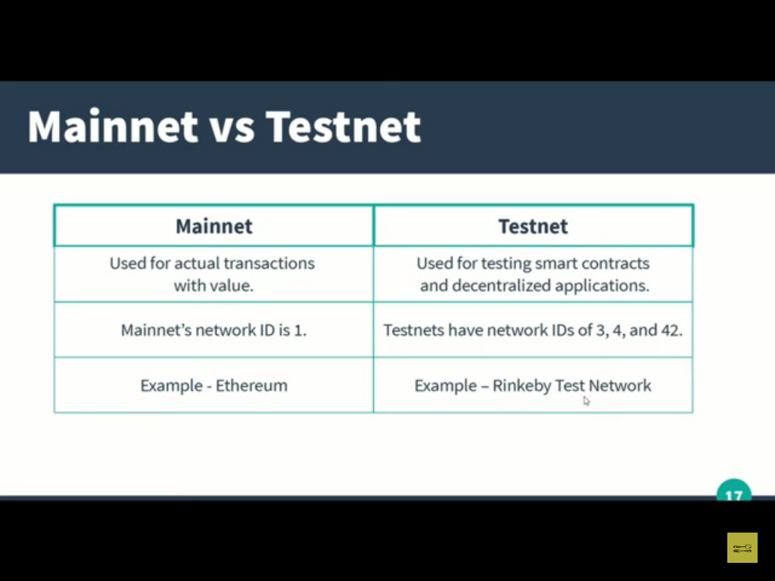

Slide 22
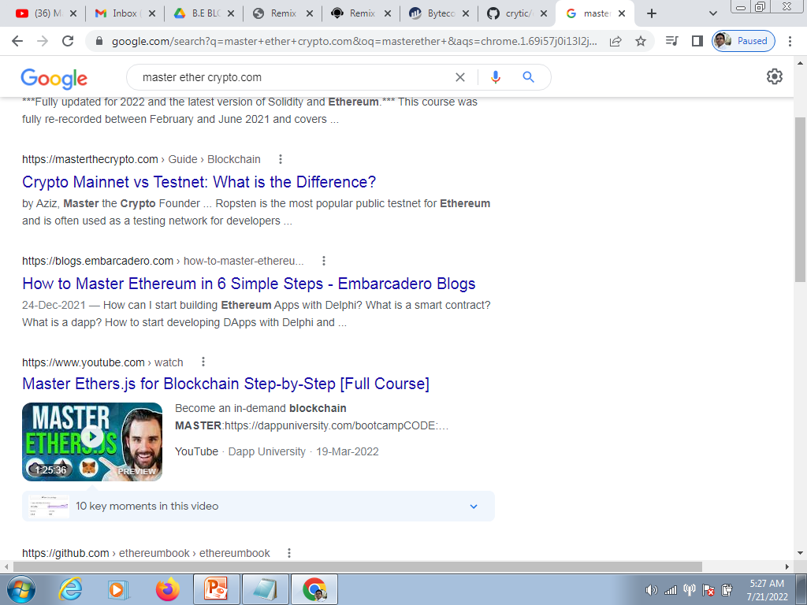

Slide 23
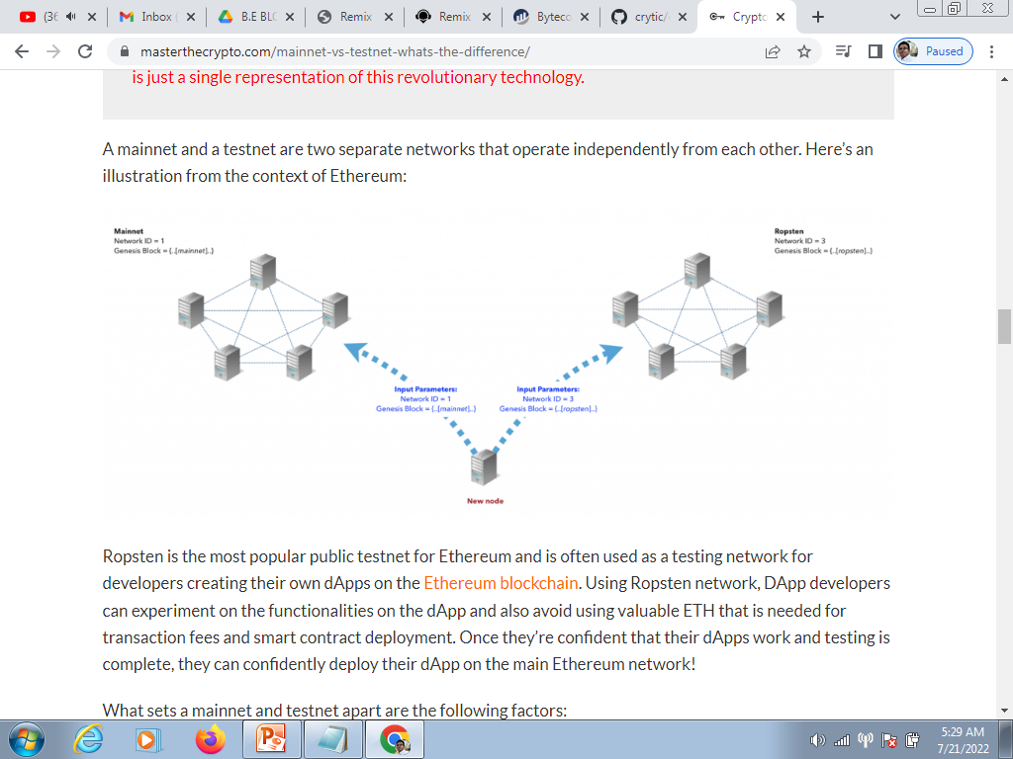

Slide 24
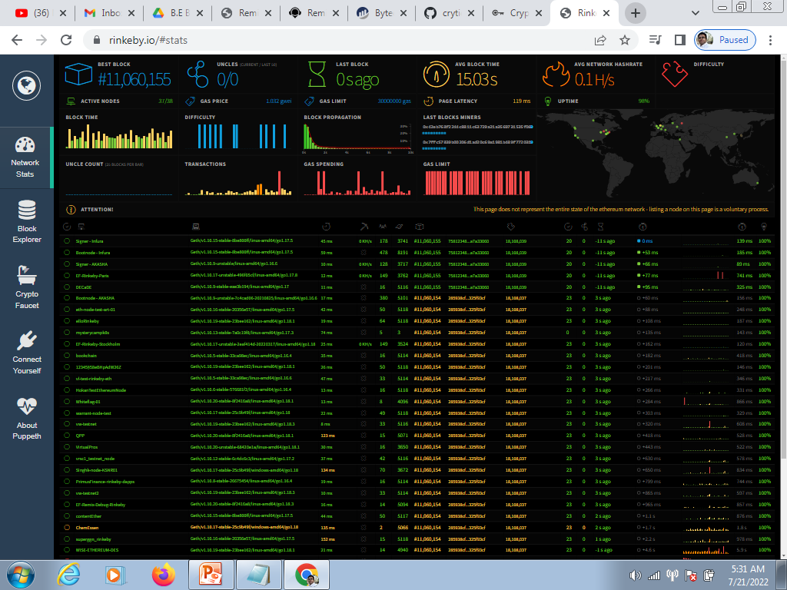

Slide 25
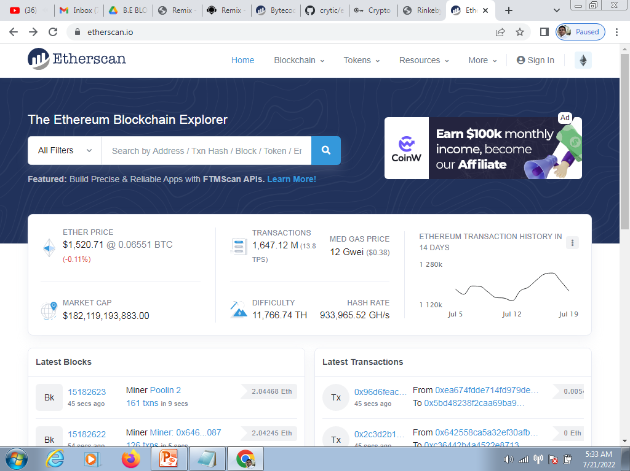

Slide 26
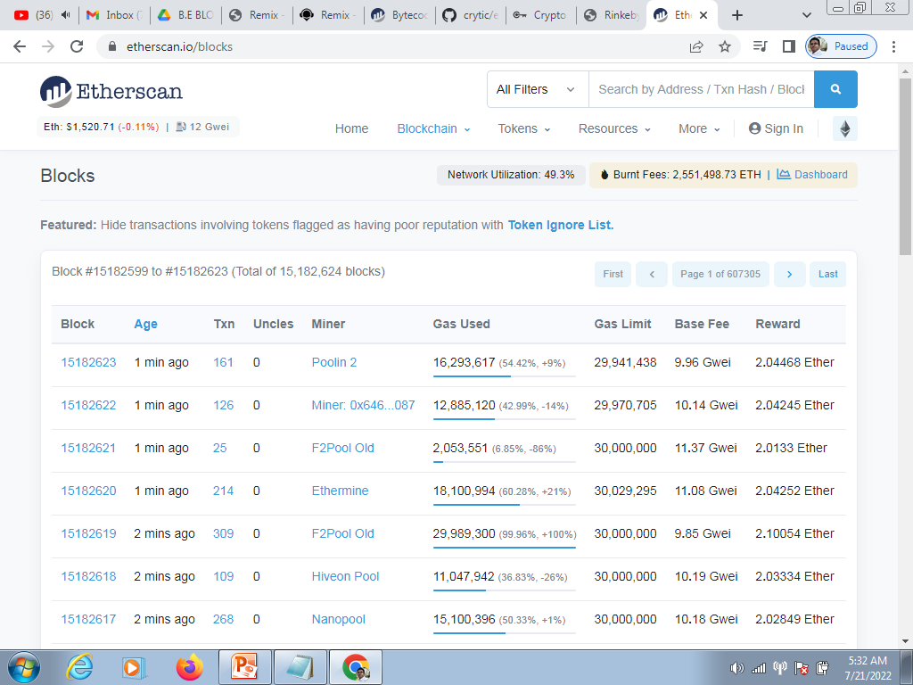

Slide 27
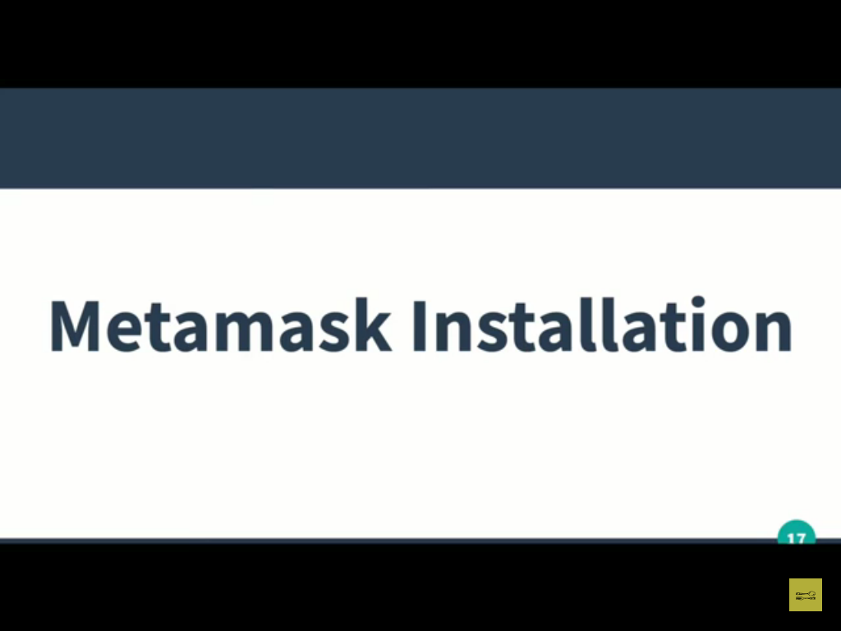

Slide 28
Metamask is popular crypto wallet It provide a gateway for all the decentralized applications.

Slide 29
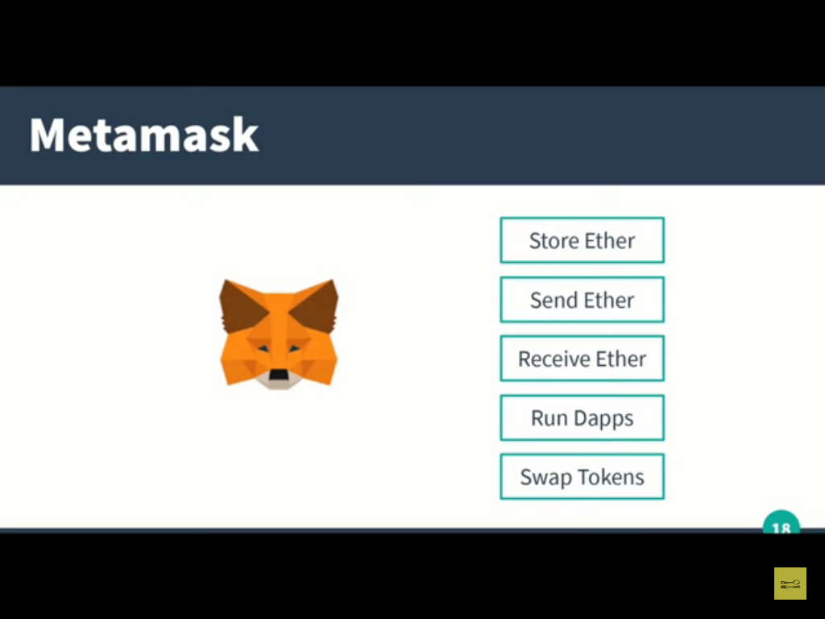

Slide 30
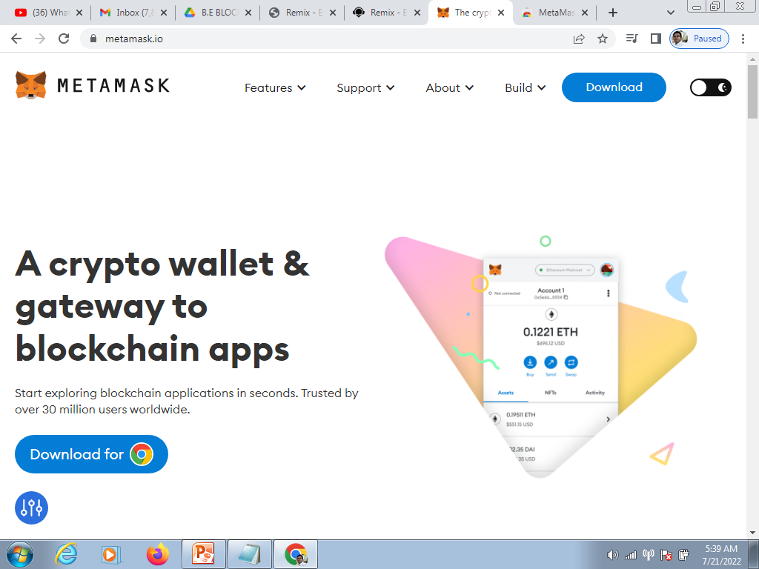

Slide 31
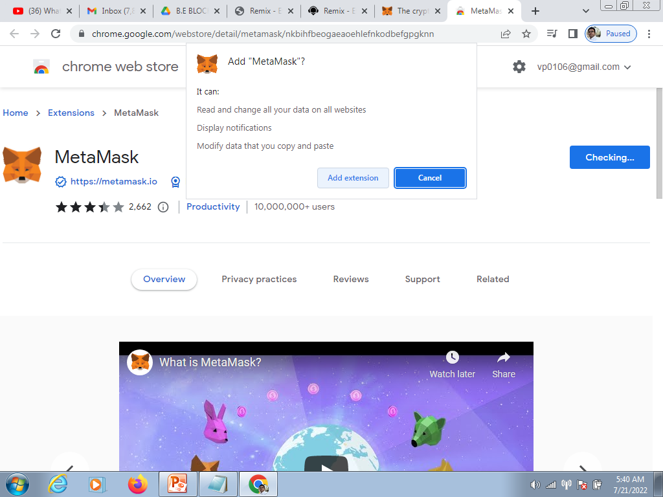

Slide 32
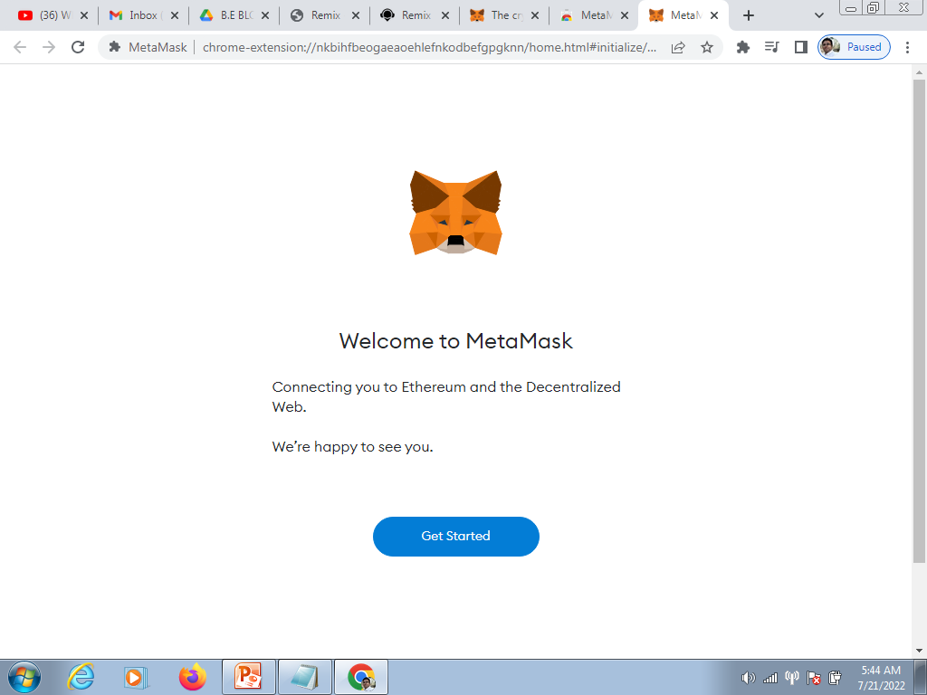

Slide 33
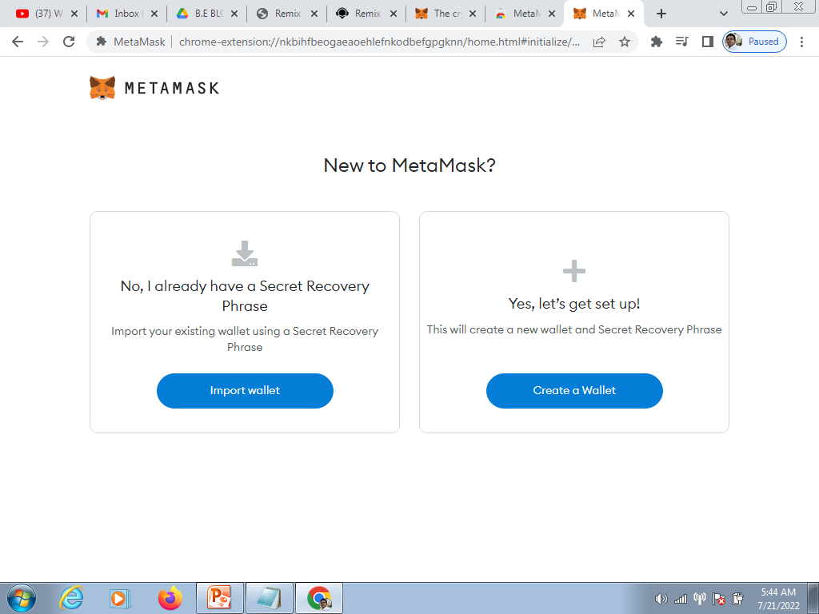

Slide 34
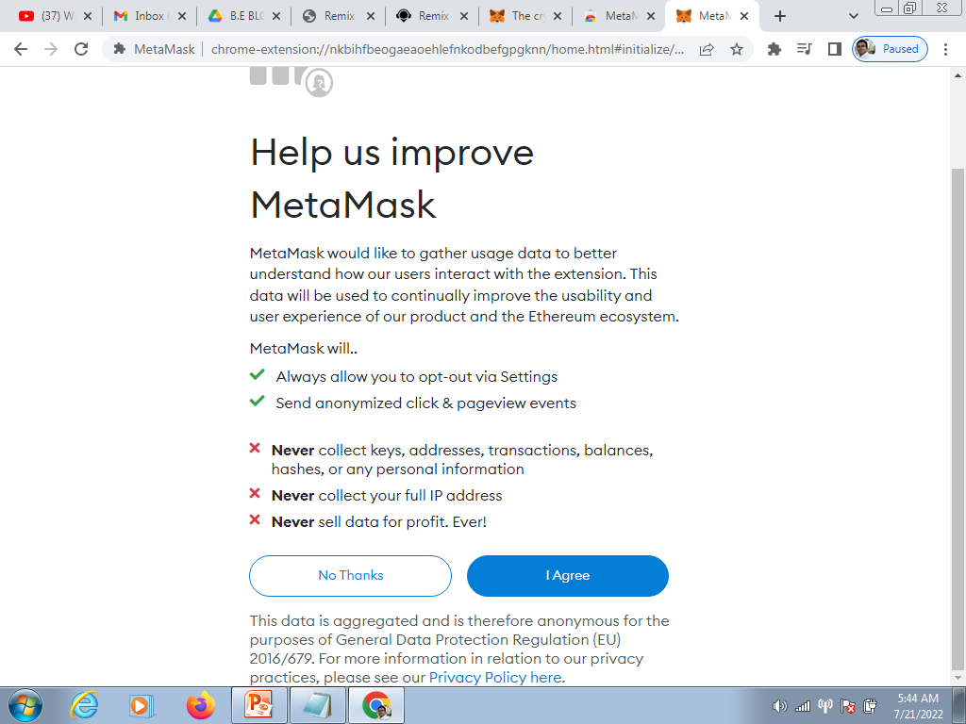

Slide 35
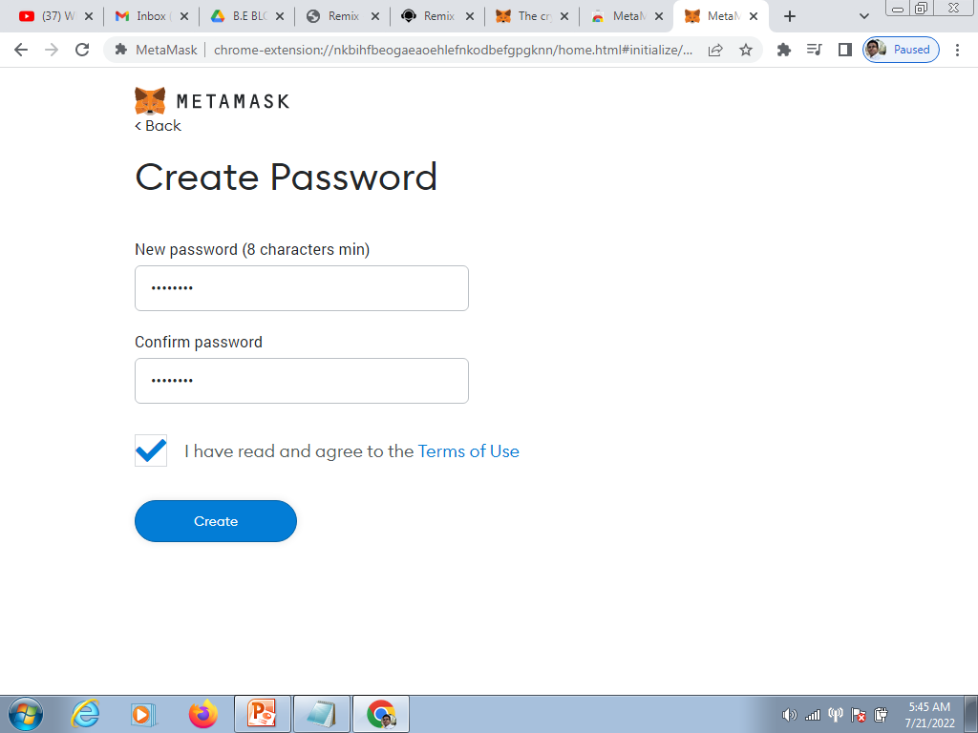

Slide 36
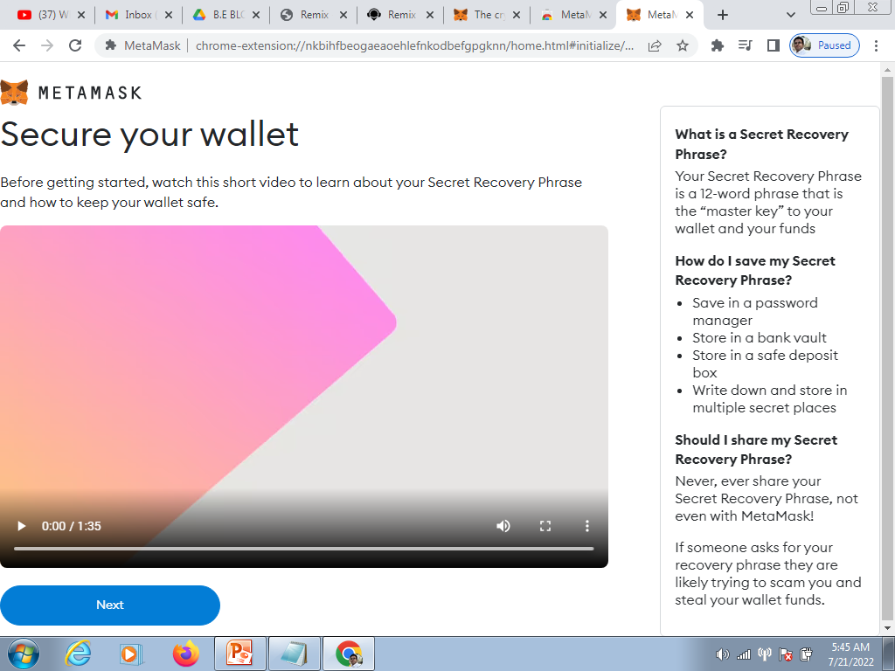

Slide 37
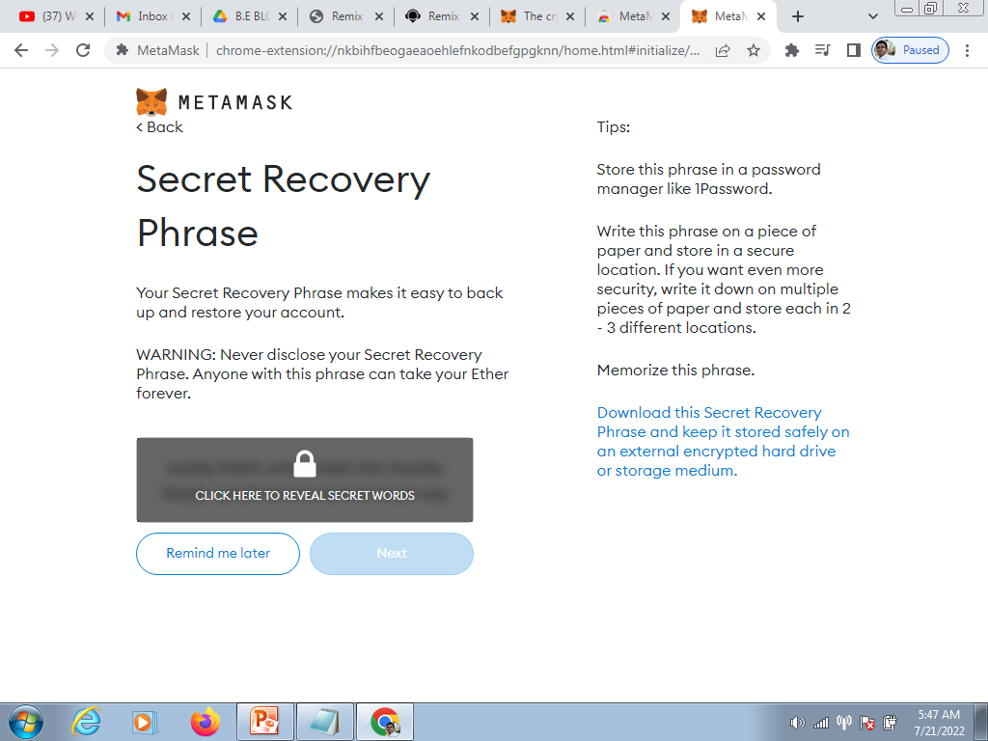

Slide 38
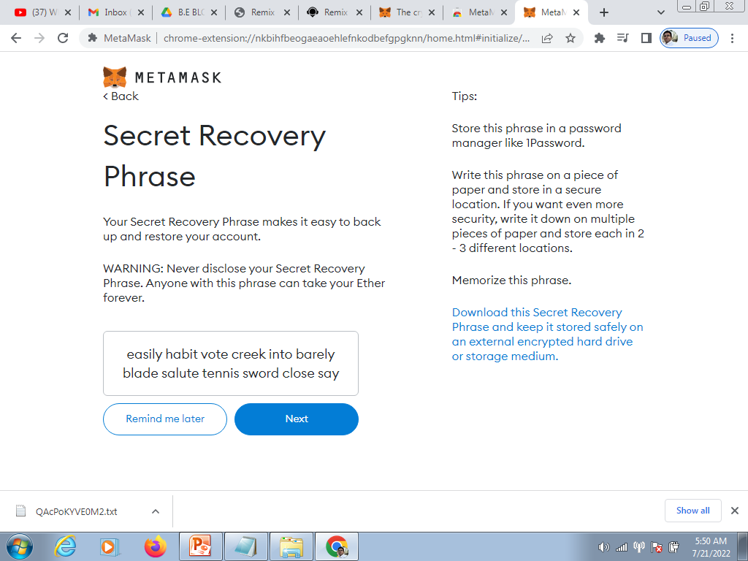

Slide 39
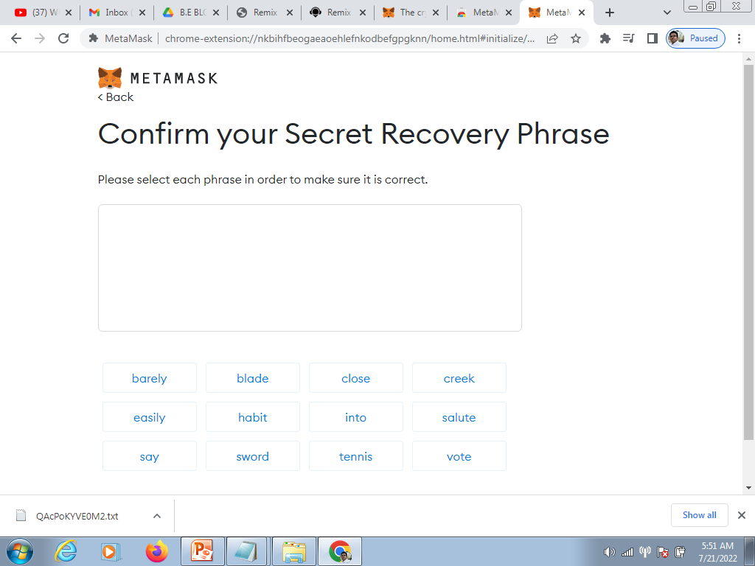

Slide 40
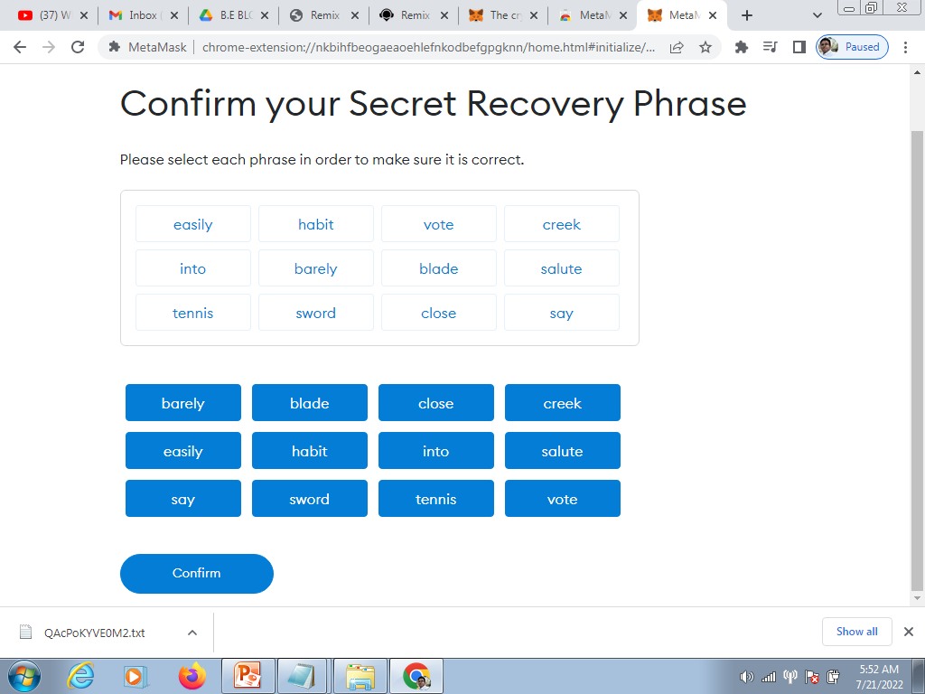

Slide 41
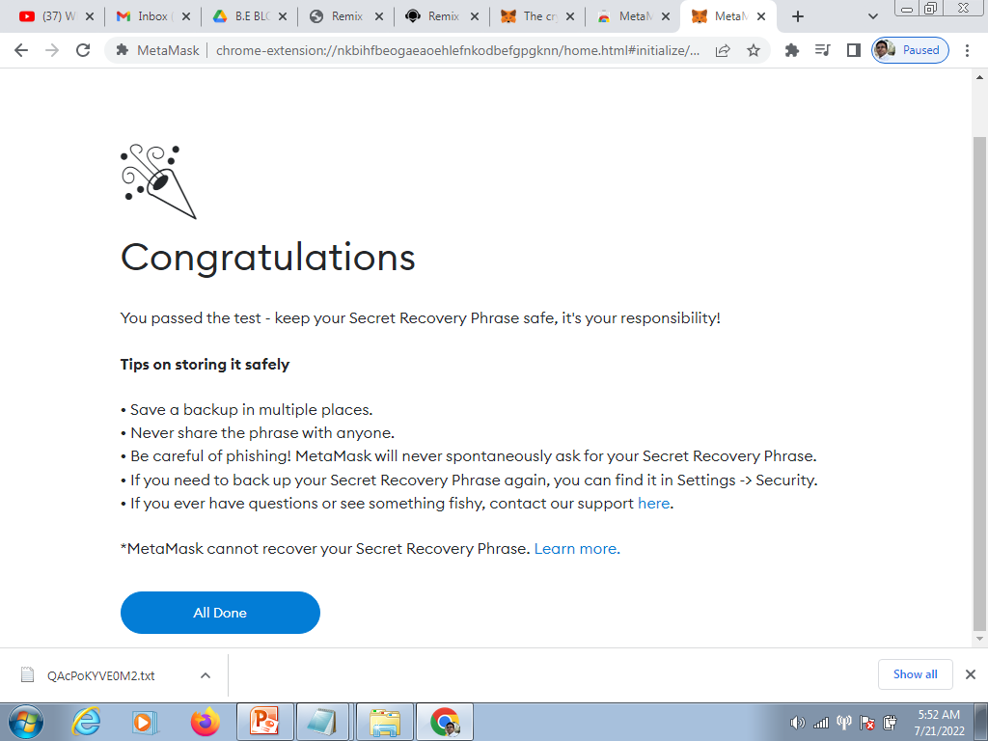

Slide 42
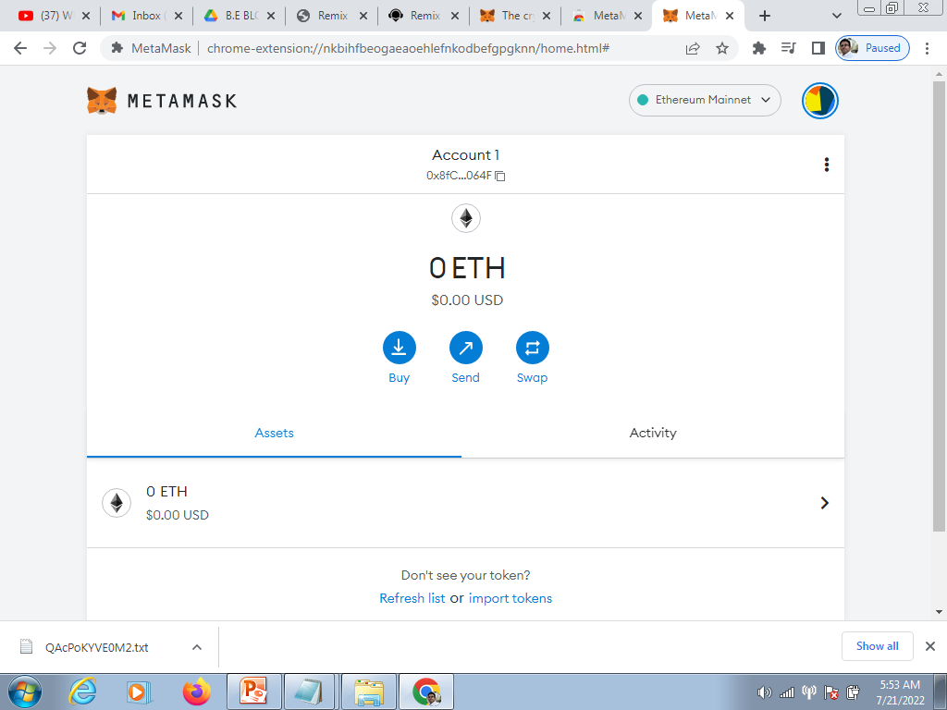

Slide 43
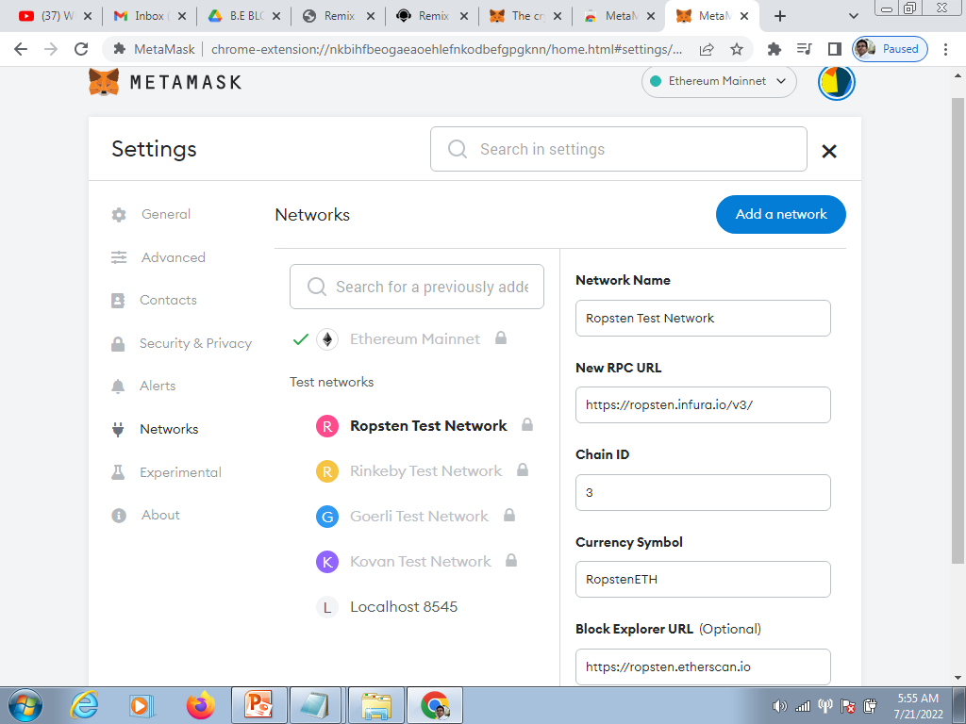

Slide 44
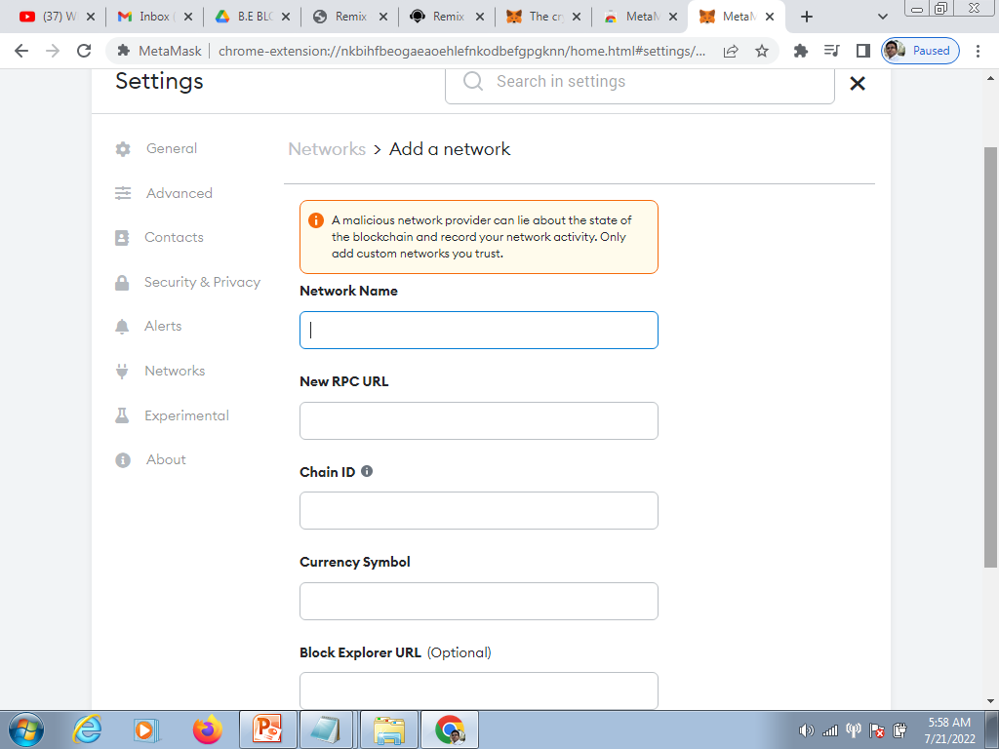

Slide 45
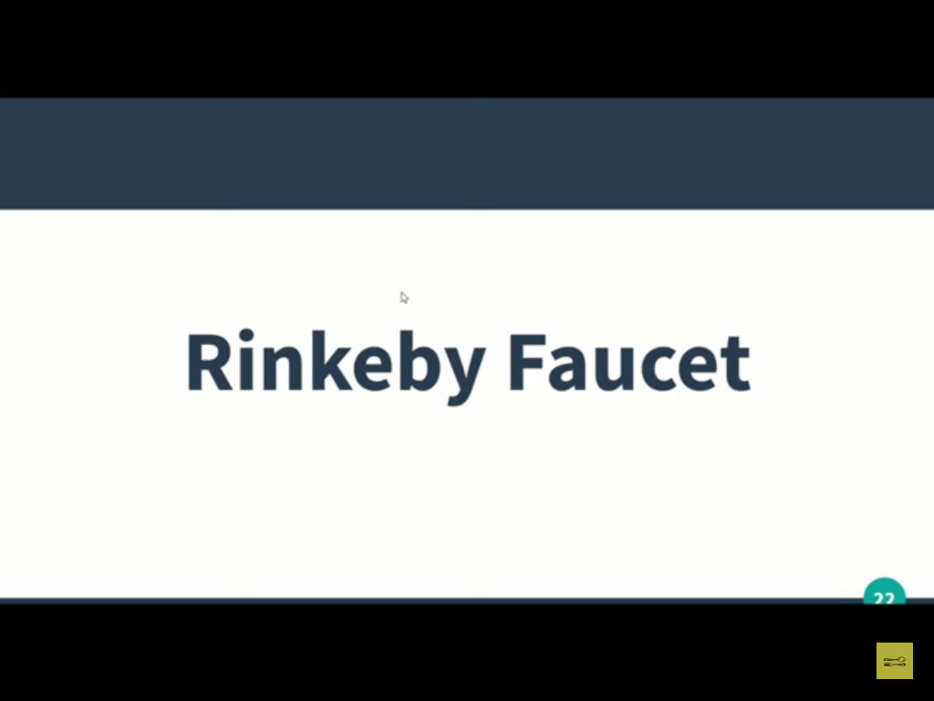

Slide 46
We can add the fake ethers to metamask using Rinkeby Faucets

Slide 47
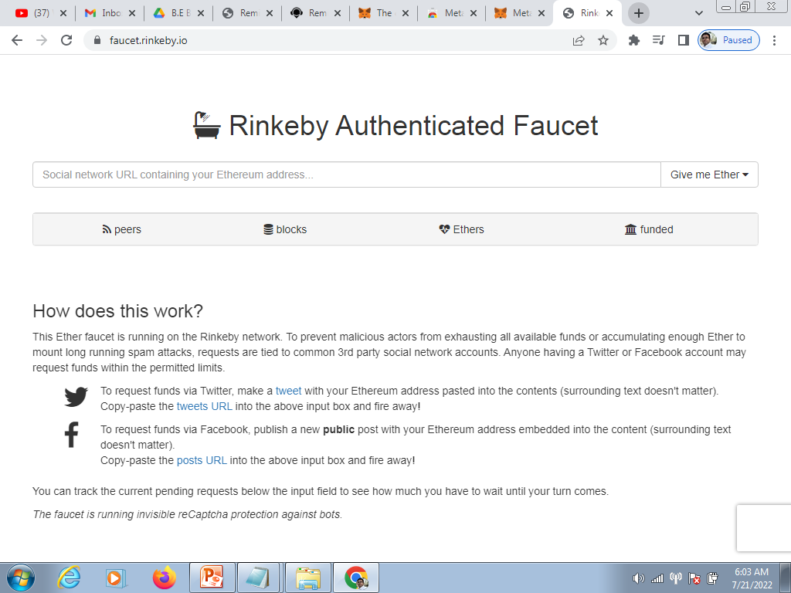

Slide 48
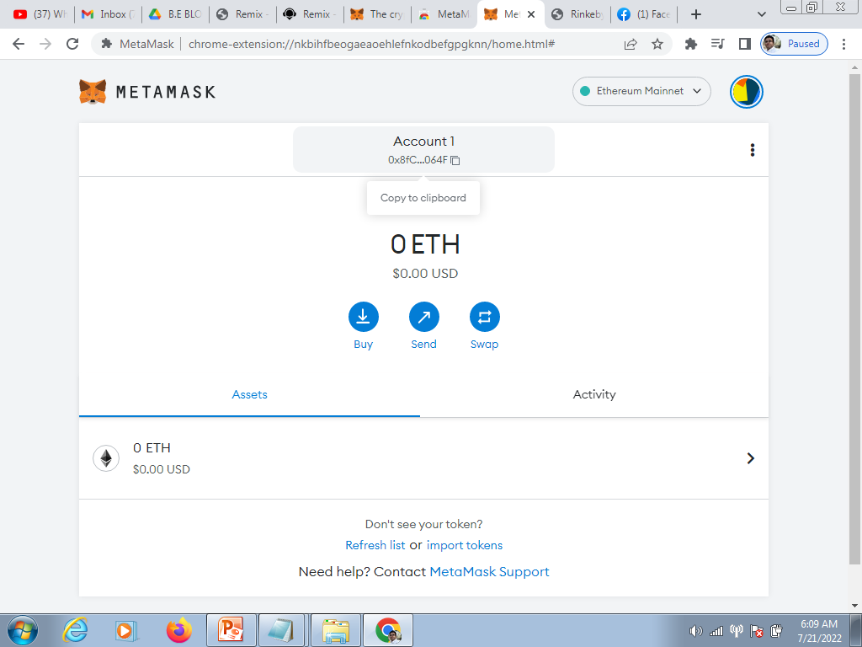

Slide 49
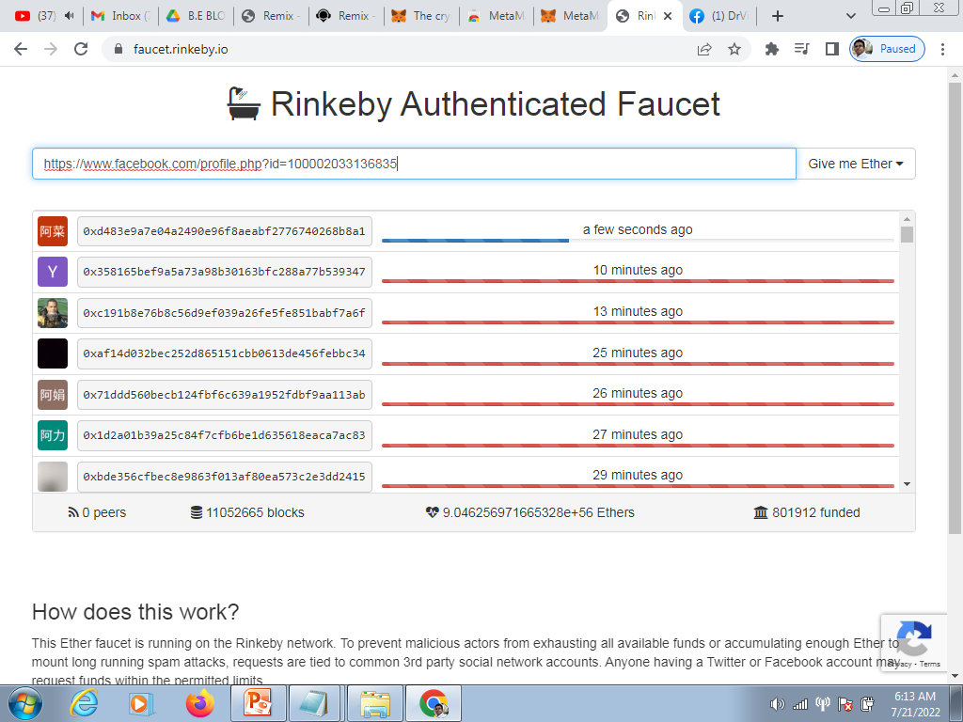

Slide 50
